Slide 1
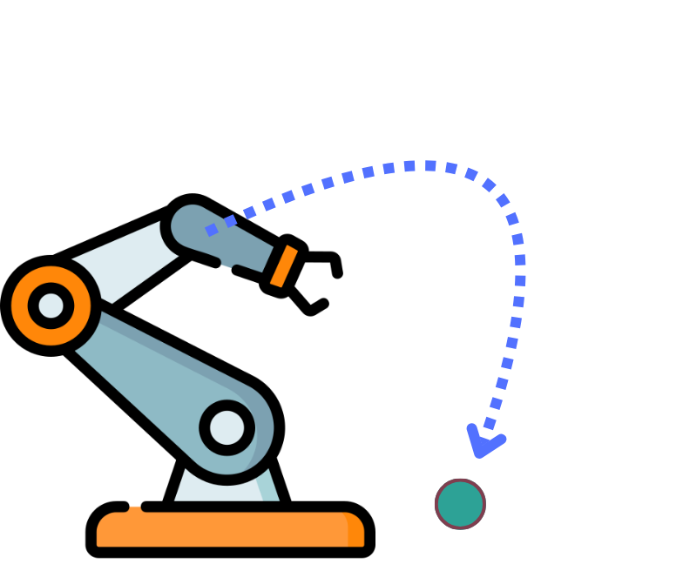


Learning Multistable Motion Primitives
from Demonstration via Multi-Attractor
Dynamics
Student:
Gabriele Di Marzo
Supervisors:
Roberto Capobianco,
Cosimo Della Santina
Daily supervisor:
Maximilian Stolzle, Rodrigo Perez Dattari,
Mariano Ramirez Montero .

Slide 2
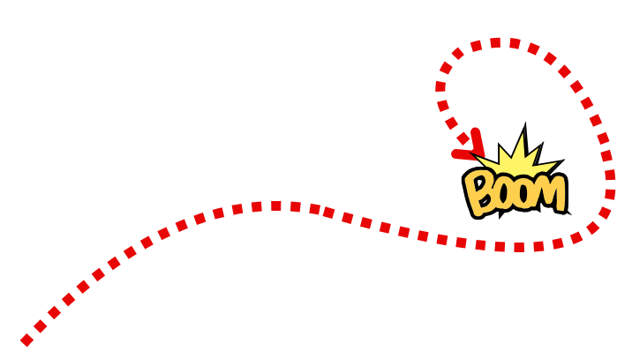
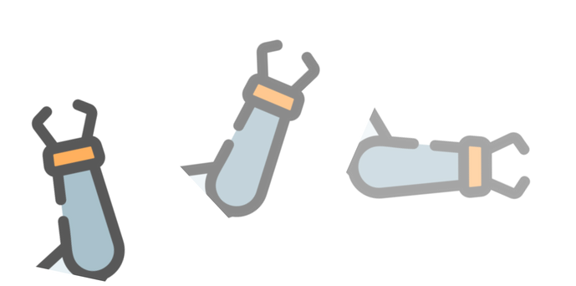
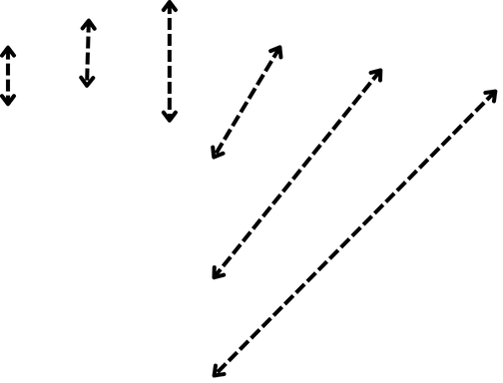
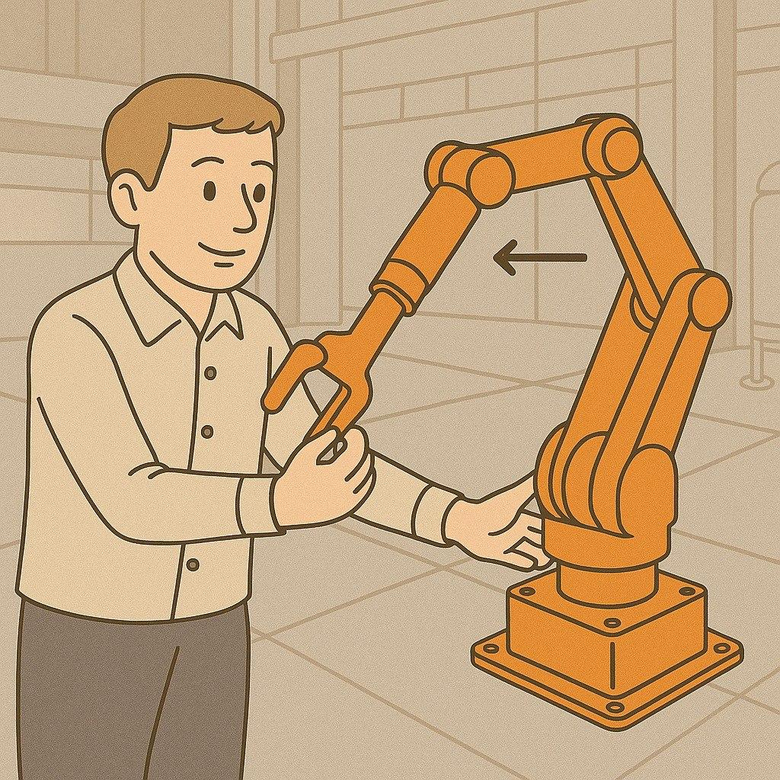
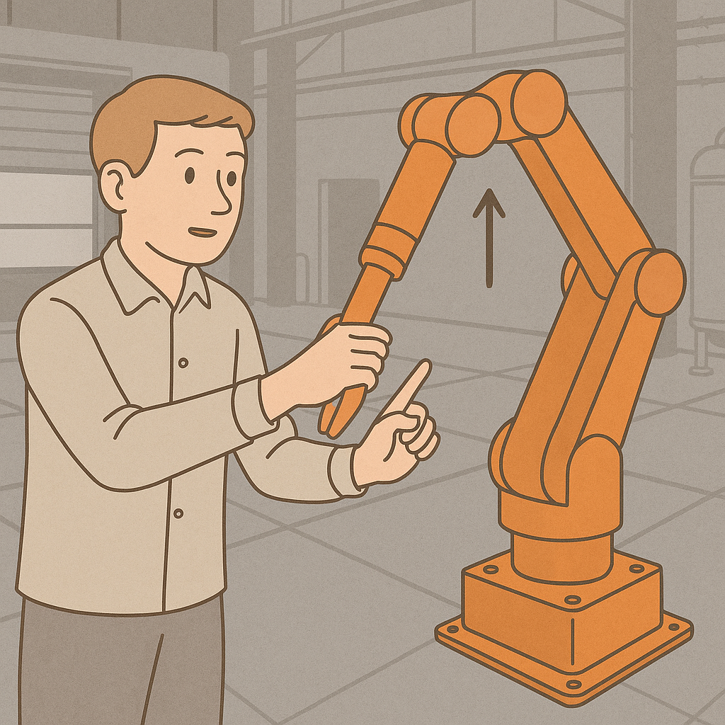
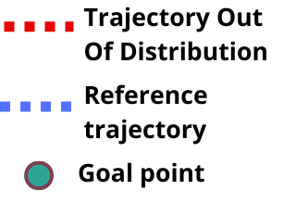
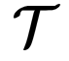
How to learn to response to new situation?
Learning From Demonstrations
with Kinesthetic Teaching
for Point to point trajectory
Trajectory shifting

Slide 3
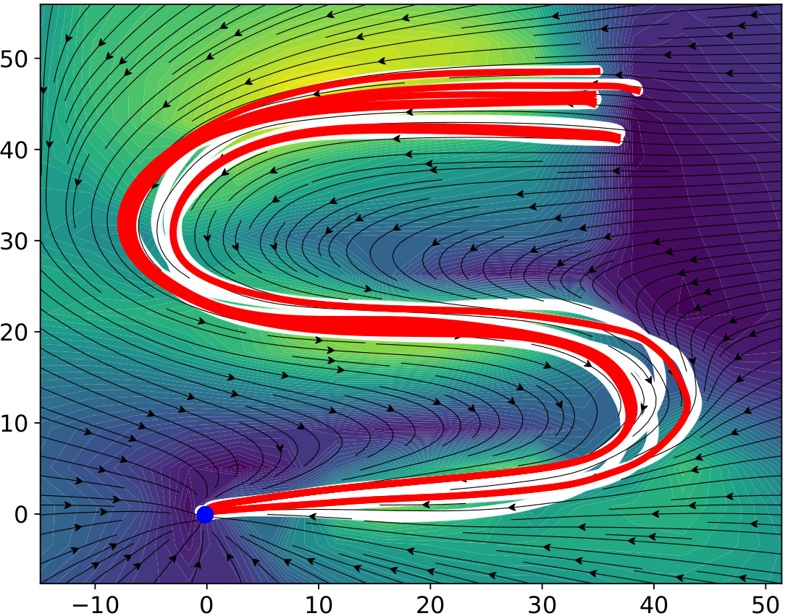
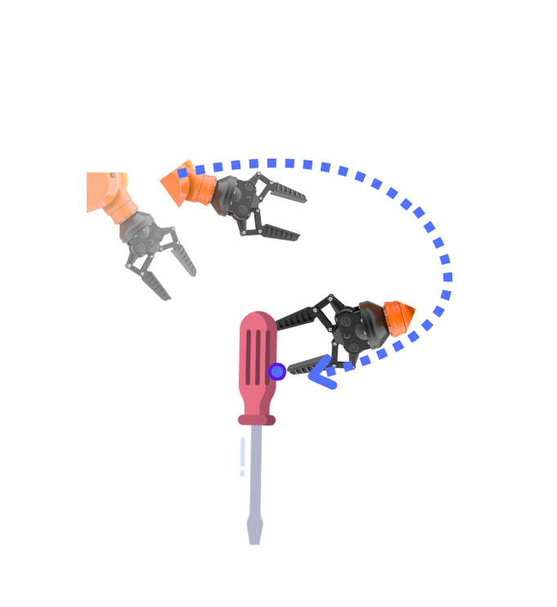
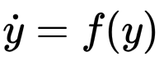
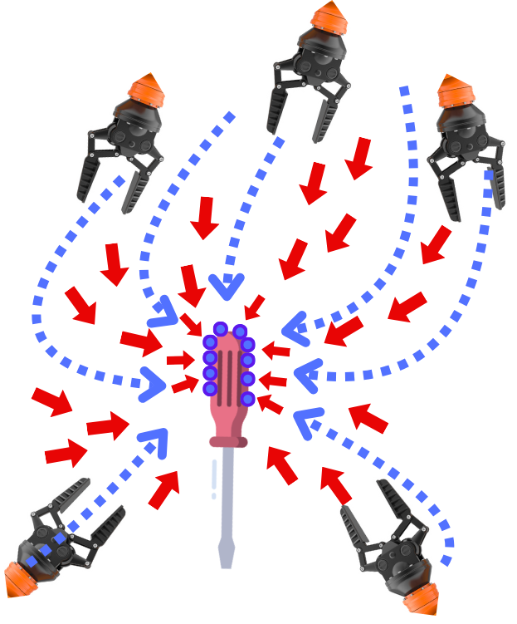
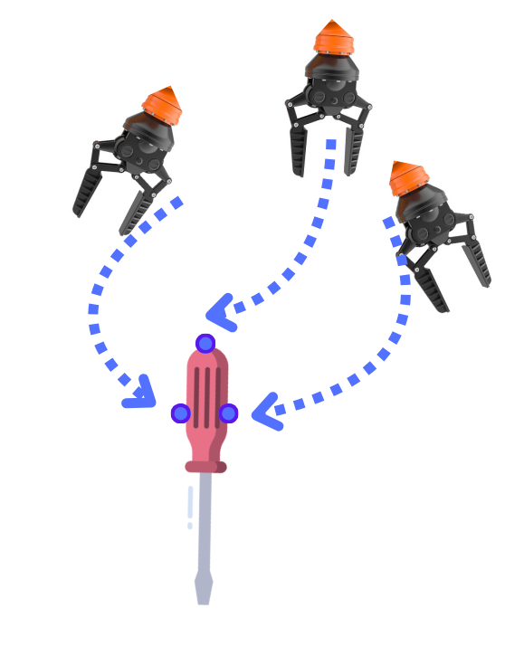
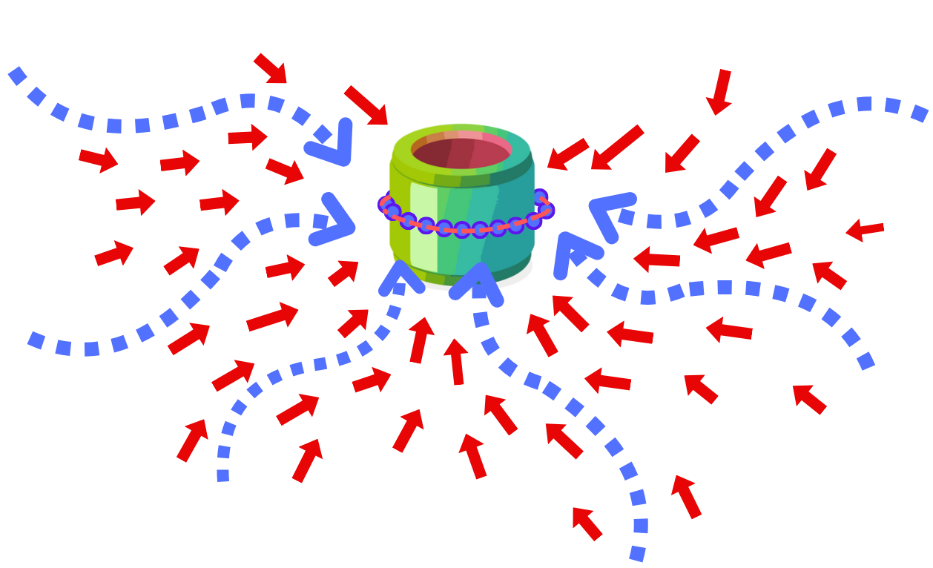
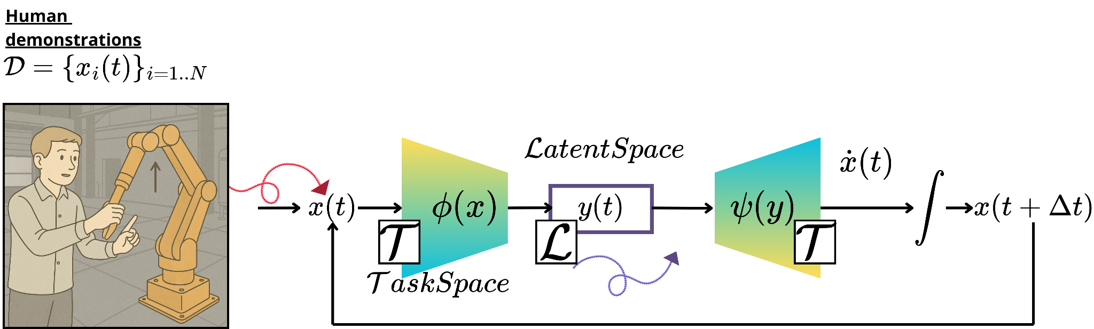
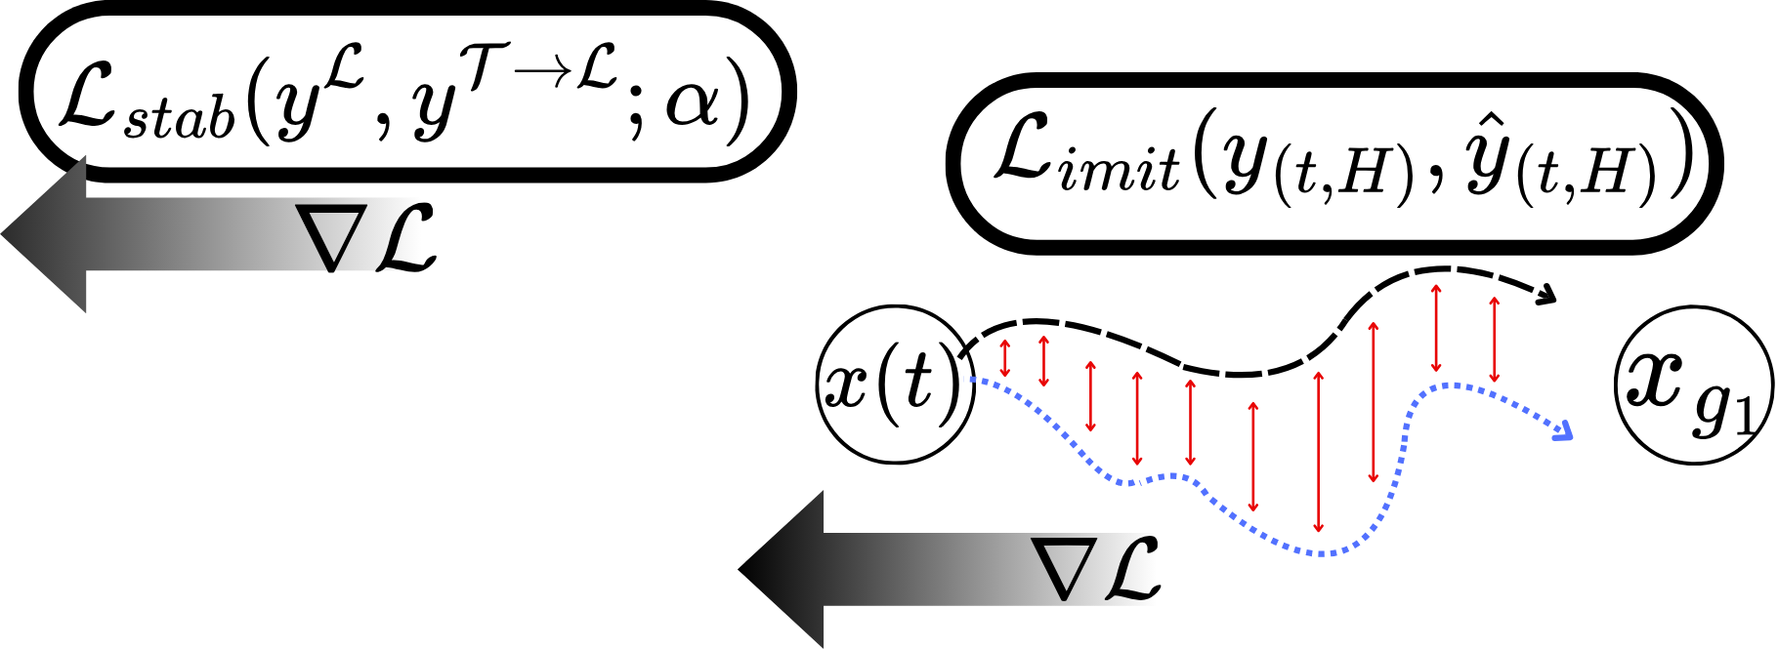
Research Motivation
Single Equilibrium
(Attractor)
We have stable system for deal with single trajectory and address stability
Dynamic Movement Primitives (DMP) associate to each motion a dynamical system
The target point to reach is the equilibrium of the dynamics
Data-driven approach for address the imitation of the reference trajectory
Using the dynamic movement primitives framework (DMP), we can associate the behaviour of the robot with a dynamical system.
Can we create a methodology for extend the single-attractor models to different trajectories with multiple attraction point ?
Can we generalize the concept of grasping point?

Slide 4
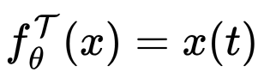
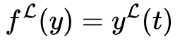
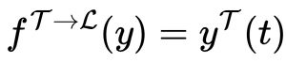
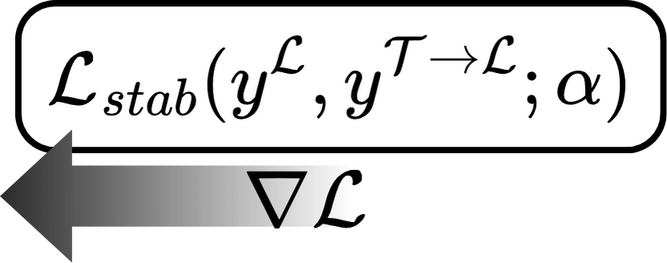
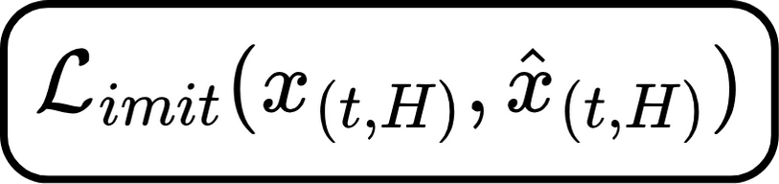
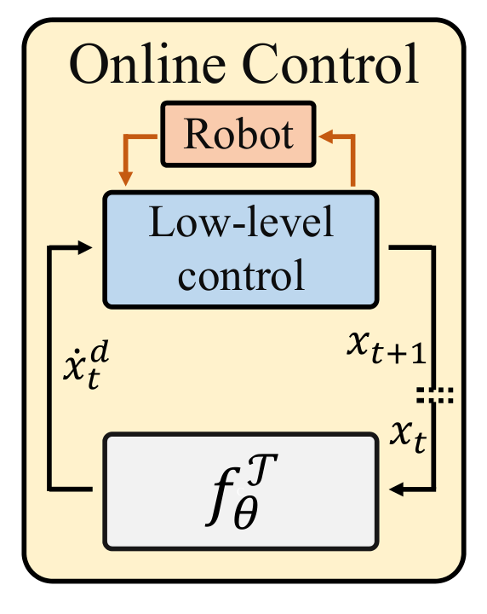
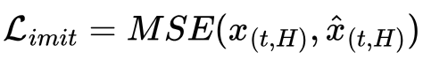
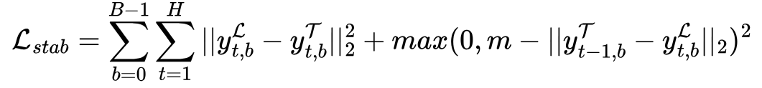
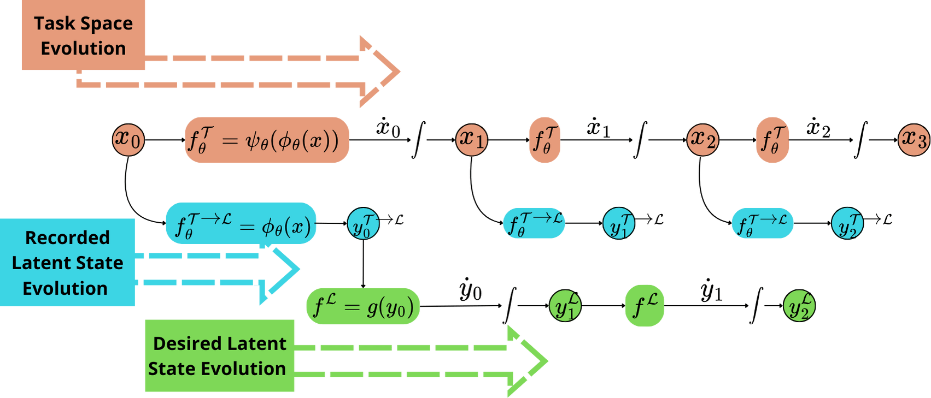


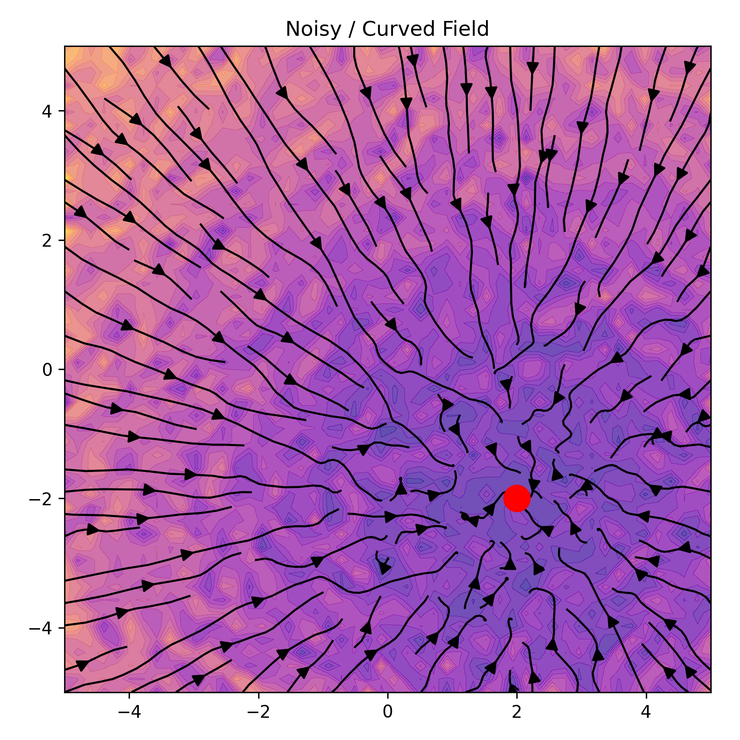
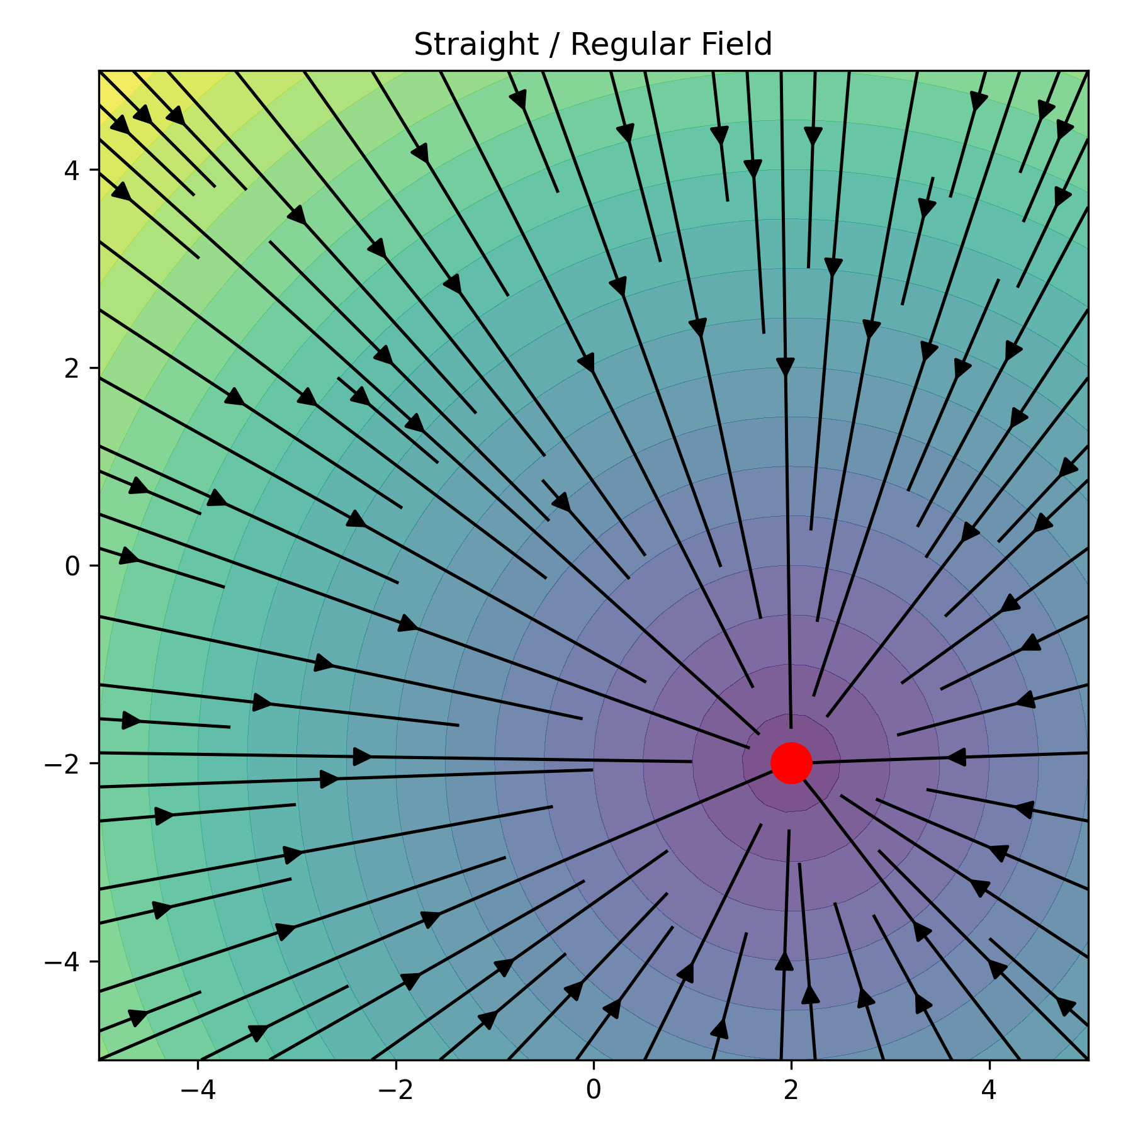
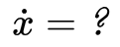
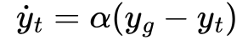
Apply Diffeomorphic mapping
Baseline: Diffeomorphism Learning ( Condor [1] )
We can transfer the stability property of the latent system to the task space
We need to collect 3 different evolution of the task and latent variable
Task space
Latent space
Close form of the latent dynamic
[1] Stable Motion Primitives via Imitation and Contrastive Learning

Slide 5
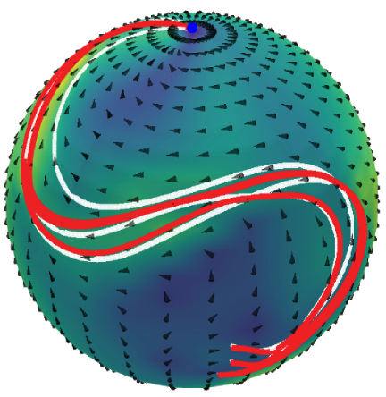
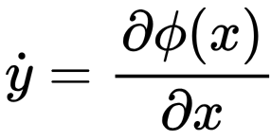
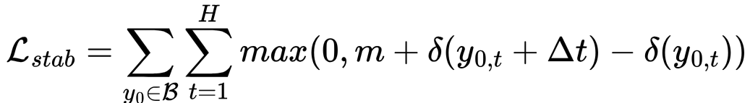
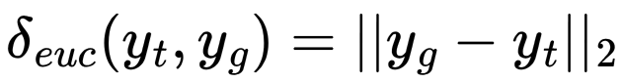
Baseline: Diffeomorphism Learning ( PUMA [3] )
New latent dynamic
Euclidean distance
Spherical distance
Single attractor trajectory on spherical domain [3]
Numerical evaluation of the latent dynamic
[3] PUMA: Deep Metric Imitation Learning for Stable Motion Primitives

Slide 6
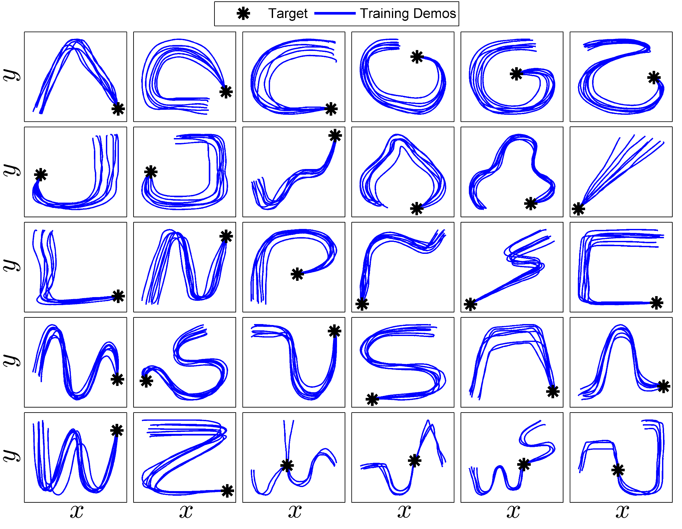
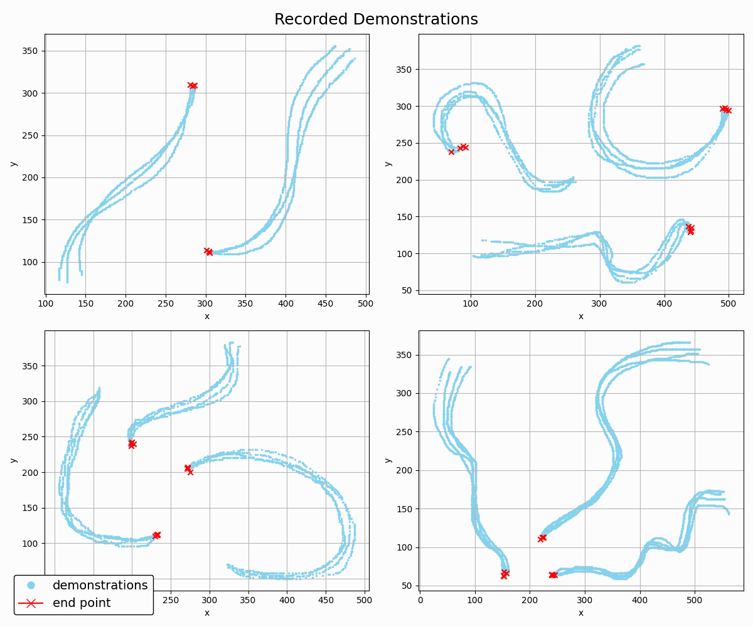
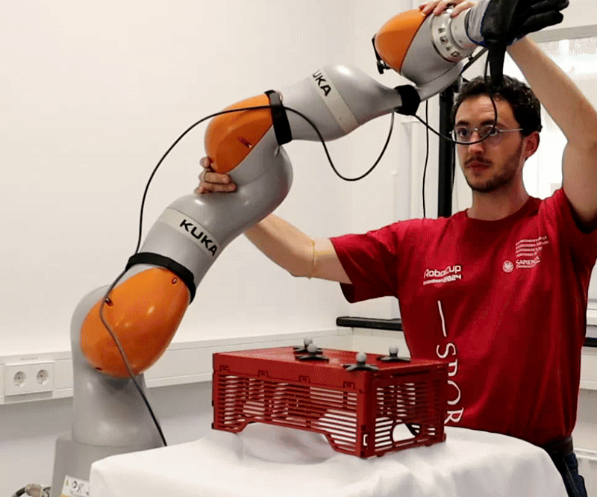
Dataset and Demonstrations
The LASA handwriting dataset [2]
Custom set of trajectories, collected with a mouse interface.
N-D trajectories have been collected using real world demonstrations
Created for the single attractor case.
Extension for multiple attractors stack together multiple trajectories, resulting in a well-partitioned workspace
[2] Learning Stable Nonlinear Dynamical Systems With Gaussian Mixture Models

Slide 7
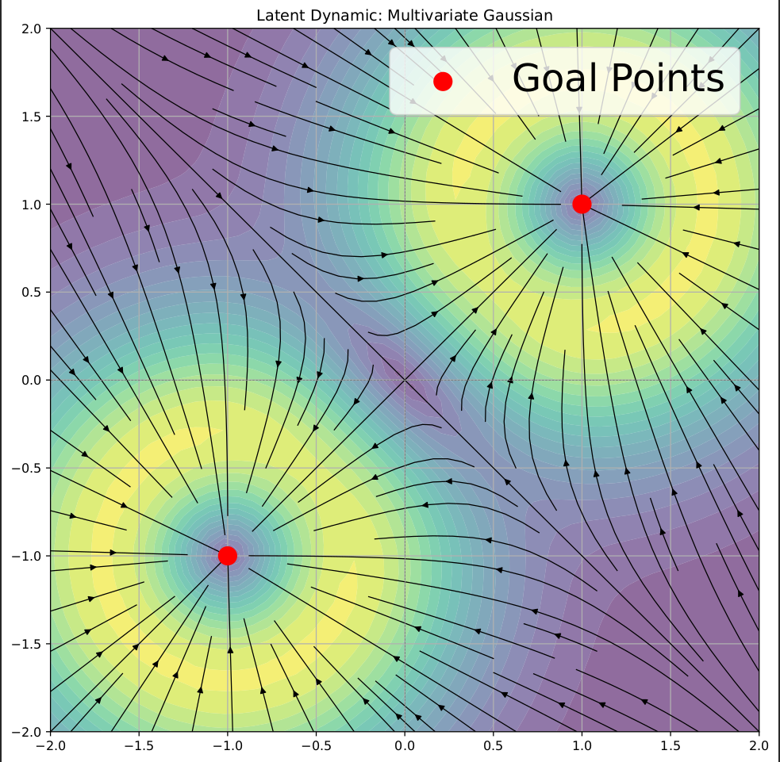
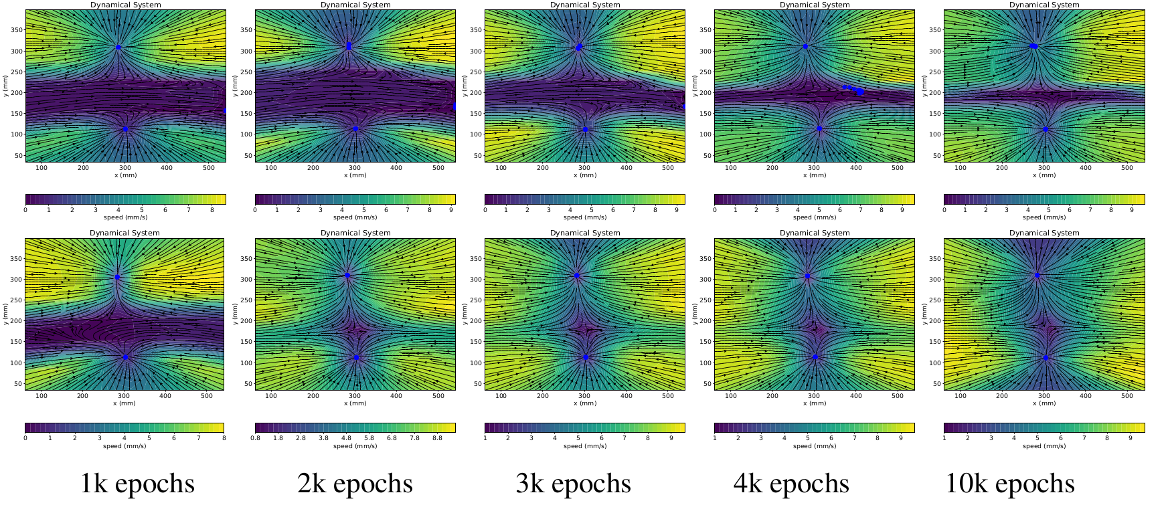
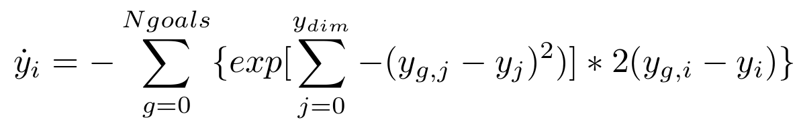
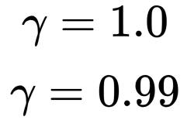
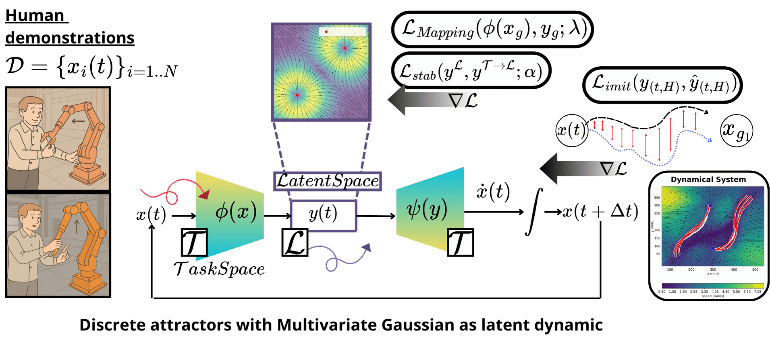
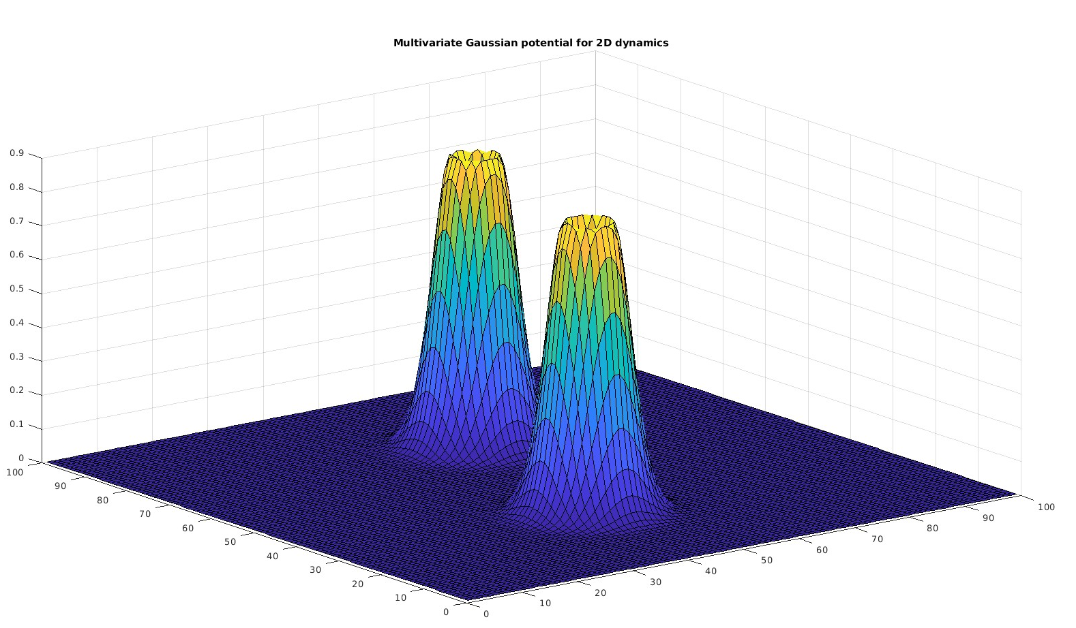
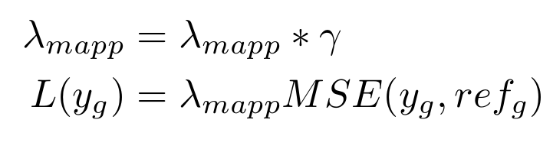
Multi-Condor, Discrete case
Evolution for two attractors
Multi-Attractors dynamic: Multivariate gaussian
The network struggle to learn the correct representation for the attractors
Mapping Loss

Slide 8
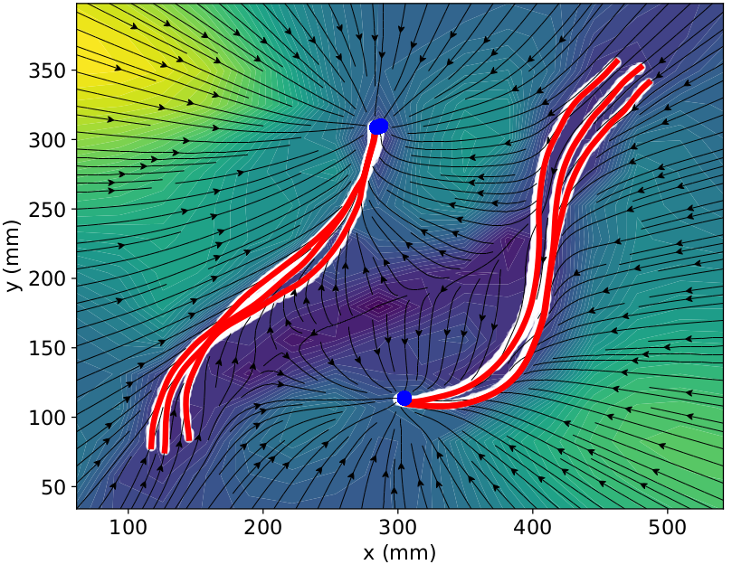
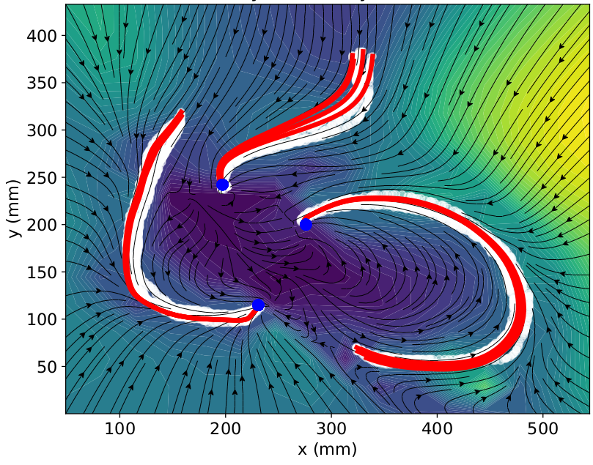
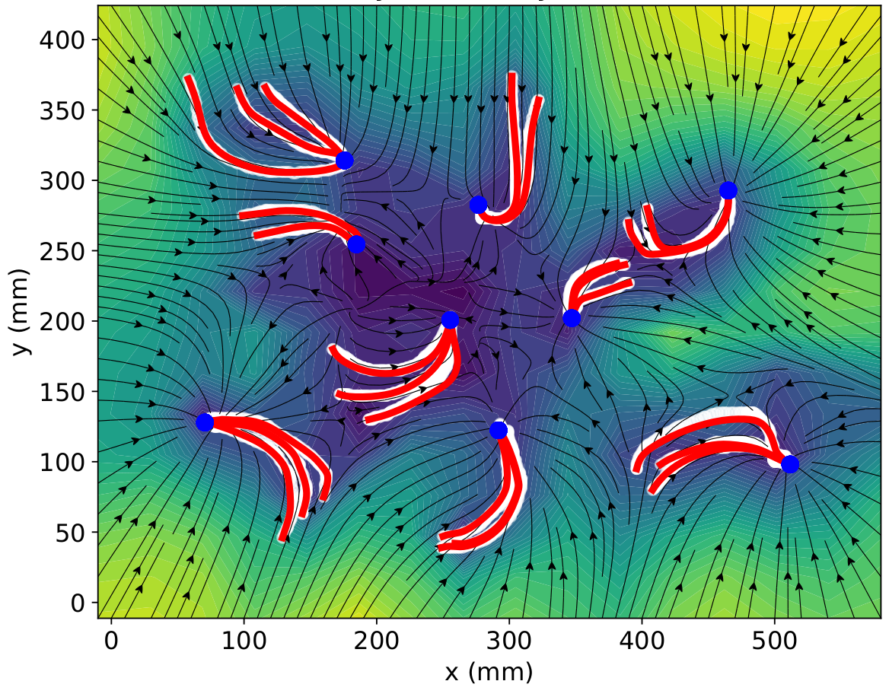
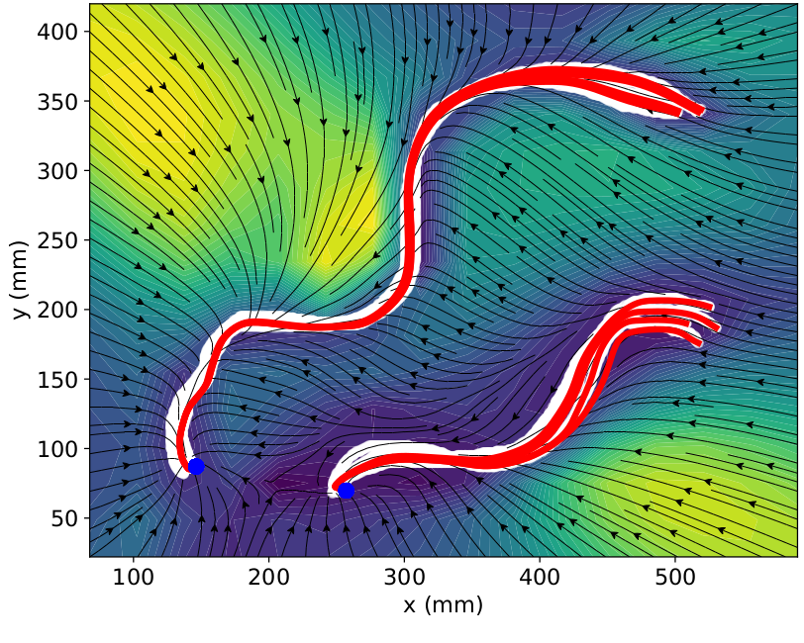
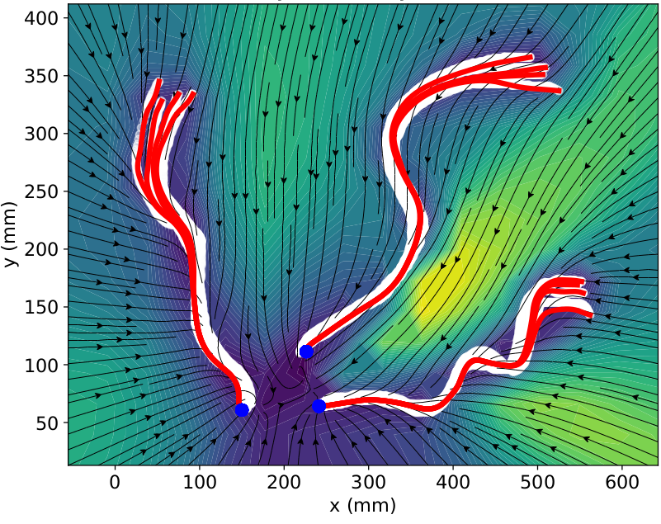
Multi-Condor, Discrete case.
Results
How many trajectory do you want?

Slide 9
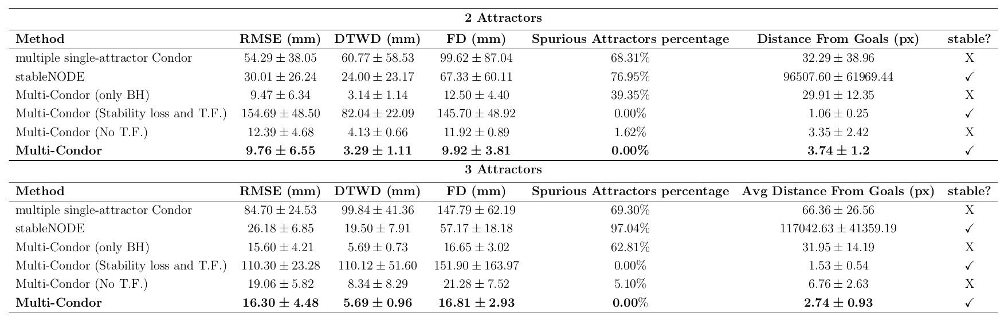
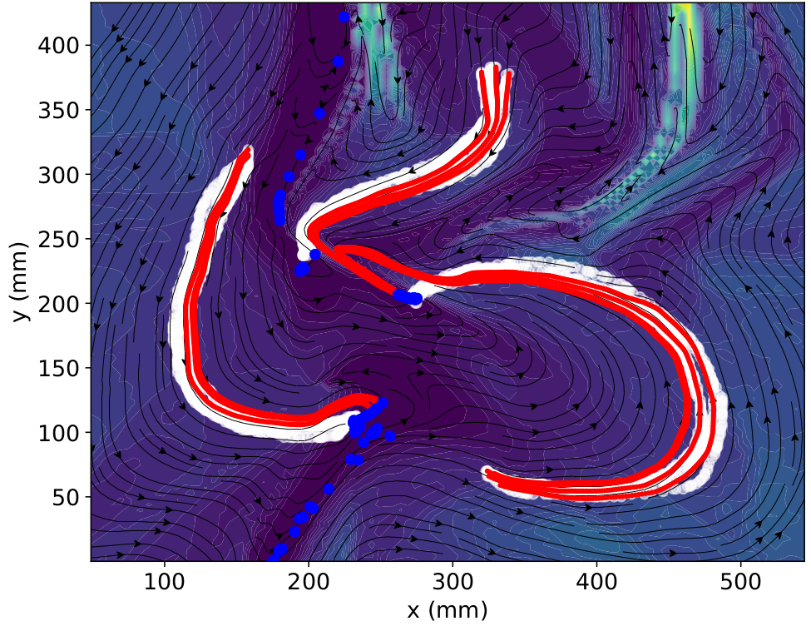
Discrete case evaluation
Stable Node [1]
Multi-Condor
Imitation metrics
Stability metrics
[1]Learning Deep Dynamical Systems using Stable Neural ODEs

Slide 10










Multi-Condor, Continuous case : Latent dynamic
Change of coordinate
Continuous attractor : Polar dynamic
Control variable for describe the unit circle
Single equilibrium dynamic
How to define these values?

Slide 11


Puma: Orientation Learning
Multi-Condor Continuous case: Architecture and Preprocessing

Slide 12










Multi-Condor, Continuous case.
Results
What shape do you you want?
Simple shape
Complex shape
Integration with the demonstrations
Single attractor component of the dynamics

Slide 13




Puma [3]: Manifold Diffeomorphisms learning
Computational efficiency is obtained with KD-Tree
Distance Selector
Single Attractor :
Multiple Attractors :
[3] PUMA: Deep Metric Imitation Learning for Stable Motion Primitives

Slide 14



Robotics experiments
Equipment:
Kuka iiwa 7
QB soft-hand end effector
OptiTrack motion capture system
The task:
reach one of the 2 handle of the box

Slide 15
Limitation and future works
Conclusion
Thank you for your attention !
We offer a set of tool and methodology for integrate multi-stable dynamical system with neural controller.
With this framework, we can:
Solve tasks with virtually infinite different demonstrations
Generalize the grasping point concept, with a continuous curve of attraction.
Learn and solve the motion task also on manifold-space
All the presented methodology exhibit stability property.
In the discrete case, future integration will address the selection of the attraction points.
Moreover, the integration of imitation loss with a continuous attraction curve struggles to accurately capture complex shape geometries.
Future research will aim to unify the different methods under a single modeling framework, with promising directions involving the use of Geometric Algebra to coherently represent points, shapes, and volumes.

